Slide 1

Revolutionizing Healthcare Delivery: The Role Of Medical Drones

Slide 2
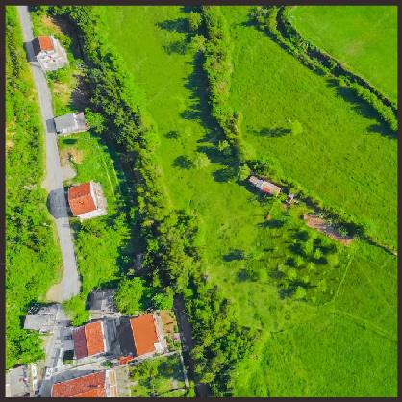
Introduction
Revolutionizing healthcare delivery through the use of medical drones has the potential to improve access to medical services and save lives. This presentation will explore the benefits of medical drones and their impact on healthcare delivery.

Slide 3
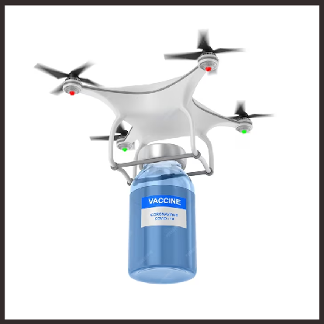
What are Medical Drones?
are unmanned aerial vehicles (UAVs) that are equipped with medical supplies and equipment. They can be used to transport medical supplies, blood, vaccines, and even organs. Medical drones can also be used to transport medical professionals to remote areas.

Slide 4
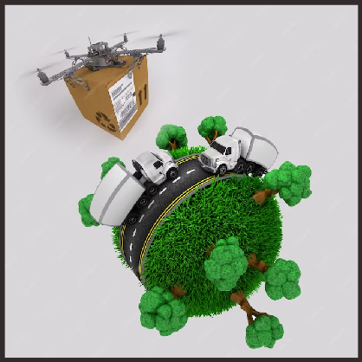
Benefits of Medical Drones
Medical drones can improve healthcare delivery by providing faster response times and reaching remote areas that are difficult to access. They can also reduce transportation costs and improve patient outcomes. Medical drones can be especially useful in emergency situations and natural disasters.

Slide 5
Methodology
1. Needs Assessment:
- Identify target areas or regions where medical drone delivery can be beneficial. Consider factors such as remoteness, lack of healthcare infrastructure, and emergency situations.
2. Drone Selection:
- Choose an appropriate drone model for medical supply delivery. Consider factors like payload capacity, flight range, and the ability to carry medical packages safely.
3. Regulatory Compliance:
- Research and adhere to legal and regulatory requirements for operating drones in the selected areas. Ensure compliance with airspace regulations, permits, and approvals.
4. Payload Design:
- Develop a secure and protective payload system for medical packages, considering factors like temperature control, shock absorption, and safe storage.
5. Route Planning:
- Implement route planning algorithms to optimize the drone's flight path. Consider factors like distance, obstacles, and weather conditions.

Slide 6
6. Data Collection:
- Gather data related to medical supply demands in target areas. This may include data on required medications, delivery frequency, and emergency situations.
7. Testing and Prototyping:
- Create prototypes of the medical supply drone and conduct rigorous testing, including
payload delivery, route accuracy, and performance in various weather conditions.
8. Integration with Healthcare Facilities:
- Collaborate with local healthcare providers to establish a seamless system for receiving, storing, and distributing medical supplies upon drone arrival.
9. Monitoring and Control:
- Implement a real-time monitoring and control system for the medical drone. This includes tracking the drone's location, monitoring payload conditions, and ensuring safe operation.
10. Safety Protocols:
- Develop safety protocols to address potential issues such as mid-flight emergencies, package damage, or drone malfunction. Ensure these protocols are well-documented and communicated to relevant parties.

Slide 7
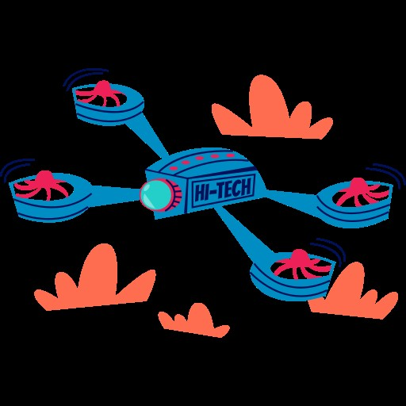
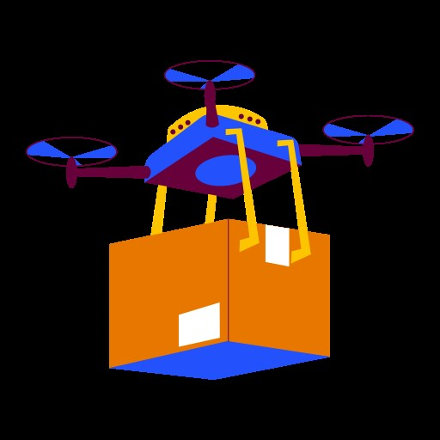

11. Pilot Training:
- Train drone pilots in safe and efficient operation. Ensure they are familiar with the routes, safety procedures, and emergency response plans.
This methodology provides a structured approach to developing and implementing a medical drone system for the delivery of essential medicines to remote or underserved areas. It encompasses various aspects, including technical development, regulatory compliance, data analysis, and community engagement.

Slide 8

Obstacle Detection Code
Drone Take Off Indication Code
Drone Landing Indication Code
Obstacle Detected
Source And Destination Navigation
Actual Location

Slide 9
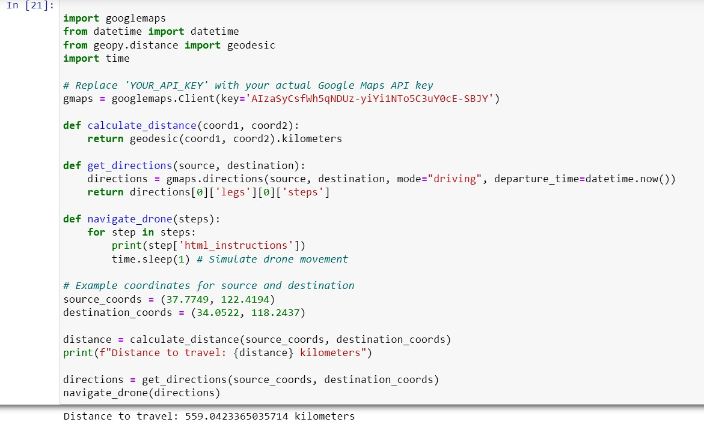
Source To Destination Code
Import Google Map & Date-Timing
Client API
Distance
Direction
Navigation
Source And Destination Cords

Slide 10

Source To Destination Code Error
.
It has been Rechecked

Slide 11
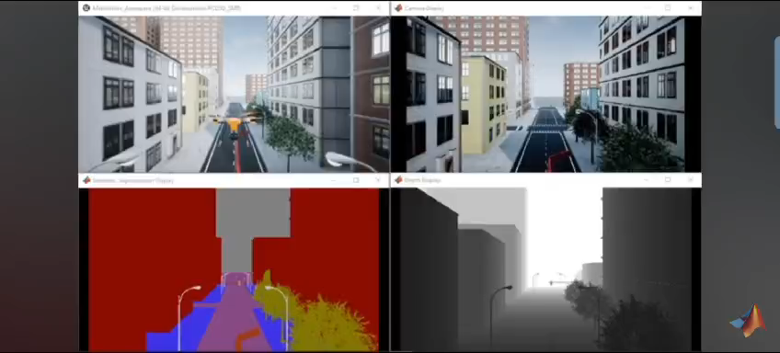
# 4 Main Points
Drone Movement
Building Detection
Living Being Detection
Foggy Seasons

Slide 12
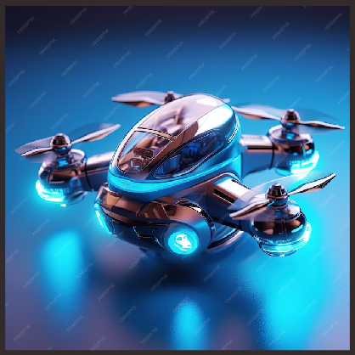
Future of Medical Drones
The future of medical drones is promising, with the potential to revolutionize healthcare delivery worldwide. As technology continues to advance, medical drones will become more reliable and efficient. However, there is still a need for further research and development to address the challenges of implementing medical drones on a larger scale.

Slide 13
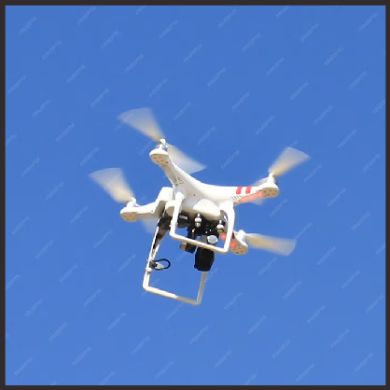
Advancements in Medical Drone Technology
Advancements in medical drone technology include improved battery life, increased payload capacity, and better navigation systems. There are also ongoing efforts to develop drones that can perform medical procedures, such as delivering defibrillators and performing CPR. These advancements will further improve the capabilities of medical drones.

Slide 14
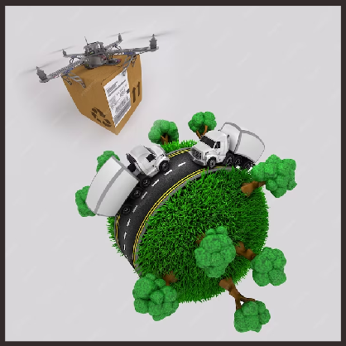
Impact on Healthcare Delivery
The impact of medical drones on healthcare delivery will be significant, with improved access to medical services and faster response times. Medical drones will also reduce transportation costs and improve patient outcomes. The use of medical drones will be especially important in remote areas and during emergency situations.

Slide 15
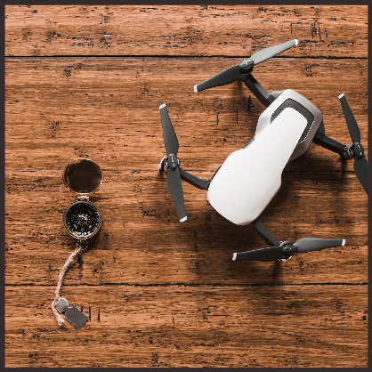
Ethical Considerations
There are several ethical considerations to be addressed when implementing medical drones, including privacy, data security, and the potential for job loss. It is important to ensure that medical drone operations are transparent and that patient data is protected. It is also important to consider the potential impact on healthcare jobs and to ensure that workers are trained to operate and maintain medical drones.

Slide 16
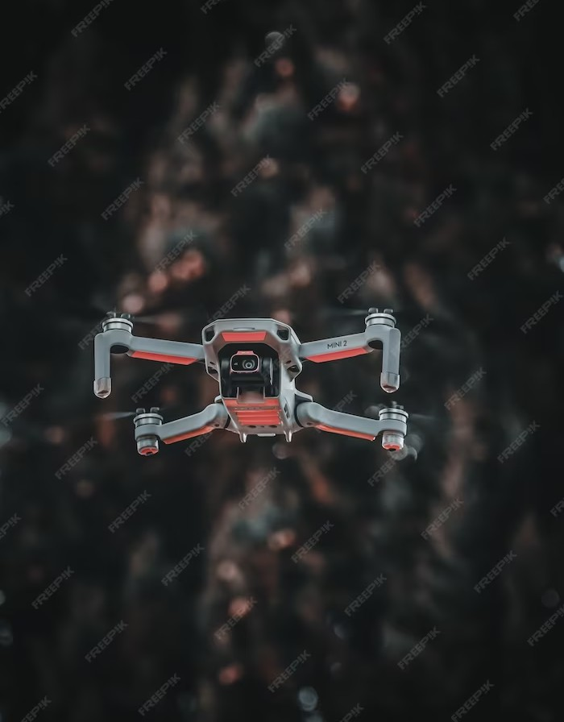
Conclusion
Medical drones have the potential to revolutionize healthcare delivery by improving access to medical services and reducing delivery times. While there are challenges to implementing medical drones, these can be addressed through proper planning and collaboration. The future of medical drones is promising, with ongoing advancements in technology and the potential to save countless lives.

Slide 17
Future Scope of Medical Drone Medical drones are very useful in accessible areas to provide medical supplies such as medicines, vaccines and medical supplies. With these medical drones, secure and rapid distribution is carried out in remote areas, war-torn areas, or inaccessible areas. Recently, the use of medical drones has become popular in government and health services to help reduce infectious and life-threatening illnesses. Medical drones are undergoing continuous research and development to produce new products with fast and accurate delivery. With the advancement of technology, medical drones have brought about augmented adoption, primarily through the means of hospitals sectors. The usage of drones in healthcare sector show immense beneficial results. Drones aid in pressing desires of sufferers with the transport of required medicines, vaccines, and such in nearby areas.

Slide 18

Thanks!
Shweta Dubey Abhishek Singh Sajal Srivastava Tushar Gaurav

